Slide 1

Welcome
Data Engineering

Slide 2
Prerequisites
This course assumes you:
Are interested in learning more about data engineering and services available in the Cloud to move, analyze, and use critical information

Slide 3
Why study this subject?
Data, in many ways, is a company’s biggest competitive advantage
Exploring how data can be moved and processed using modern Cloud offerings can give you useful context for how the data is utilized

Slide 4
My pledge to you
I will...
Make this interactive
Ask you questions
Ensure everyone can speak
Use an on-screen timer

Slide 5
Objectives
At the end of this course you will be able to:
Speak to high-level concepts related to data engineering and data management in the Cloud

Slide 6
Agenda
High-level data management lifecycle
Data engineering on AWS
Big data overview in AWS

Slide 7
Data Management Lifecycle

Slide 8
Data Management – Stages
Ingestion
Scrubbing & Normalization
Aggregation
Analysis & Intelligence Gathering

Slide 9
Data Ingestion
Could be via message exchange or streaming
Depending on size/scope, may translate to LARGE amounts of incoming data
Ingestion
Scrubbing & Normalization
Aggregation
Analysis & Intelligence Gathering

Slide 10
Data Ingestion
Because of potential scale, bandwidth may be a concern
Depending on application, latency may also be a concern
Data may require translation (e.g., from low-level bytes to object or JSON)
Ingestion
Scrubbing & Normalization
Aggregation
Analysis & Intelligence Gathering
Notes:
Medical info, autonomous vehicles, streaming data may be less tolerant of latency issues

Slide 11
Data Ingestion
Event hubs or streaming analytics platforms support ingestion at scale
Provide time and context-aware processing for correct sequencing
Data may flow through intermediate storage on way to final processing
Depending on sensitivity of data, could require robust security at each stop
Ingestion
Scrubbing & Normalization
Aggregation
Analysis & Intelligence Gathering

Slide 12
Data Ingestion – What About the Edge?
Edge components (e.g., gateways) can help optimize
Preliminary processing at the edge can be used to filter what really matters
Potential for bundling or compressing data for transmit to cloud
Can help with bandwidth or latency issues
Ingestion
Scrubbing & Normalization
Aggregation
Analysis & Intelligence Gathering
Notes:
For example, streaming applications – multiple, related pieces of the stream can be gathered at the Edge and processed as a complete unit

Slide 13
Data Scrubbing & Normalization
Depending on payload, some portions of the data may not be needed
Or some portions might contain sensitive detail
Those parts not needed or sensitive can be “scrubbed” to exclude
Ingestion
Scrubbing & Normalization
Aggregation
Analysis & Intelligence Gathering

Slide 14
Data Scrubbing & Normalization
Represents another potential optimization that can preserve storage
In other cases, similar data may be coming in multiple, disparate formats
Ingestion
Scrubbing & Normalization
Aggregation
Analysis & Intelligence Gathering

Slide 15
Data Scrubbing & Normalization
Normalization can bring consistency to the disparate content
By normalizing, becomes a single dataset for comprehensive analysis
Normalization may happen as part of ingestion or as part of a separate step
Ingestion
Scrubbing & Normalization
Aggregation
Analysis & Intelligence Gathering
Notes:
Temperature/humidity is temp/humidity – regardless of the device and how the device communicates it

Slide 16
Data Scrubbing & Normalization – What About the Edge?
Depending on complexity, may execute faster closer to the data
Might involve proprietary algorithms best kept within full control
Allows addressing of sensitive data before routed to Cloud
Can also provide additional optimization (relative to bandwidth)
Ingestion
Scrubbing & Normalization
Aggregation
Analysis & Intelligence Gathering

Slide 17
Data Aggregation
Helps provide full picture of data from multiple streams
May also be used to enrich with info from other data sources
Data will be stored in persistent storage for downstream analysis & reporting
Ingestion
Scrubbing & Normalization
Aggregation
Analysis & Intelligence Gathering

Slide 18
Data Aggregation
In statistical analysis, the larger the sample size, the more accurate the inference
To manage costs, large sets of data may leverage different types of storage:
Hot storage – most recent data and most relevant for current analysis
Cool storage – data not actively used but potentially relevant (short-term trends)
Cold or archive storage – data kept for historical purposes and long-term trending
Security of the stored data and encryption at rest become critical
Ingestion
Scrubbing & Normalization
Aggregation
Analysis & Intelligence Gathering

Slide 19
Data Aggregation – What About the Edge?
Provides an additional layer of storage
Data not transmitted to Cloud (due to optimizations) may still be valuable to keep
Enables storage of sensitive data in “raw” format in controlled environment
Can help balance costs against short to mid-term retention requirements
Ingestion
Scrubbing & Normalization
Aggregation
Analysis & Intelligence Gathering

Slide 20
Data Analysis & Intelligence Gathering
In the digital age, data is the competitive edge
Companies that manage their data as a critical asset succeed
Keys:
Aggregating efficiently
Analyzing effectively
Ingestion
Scrubbing & Normalization
Aggregation
Analysis & Intelligence Gathering

Slide 21
Data Analysis & Intelligence Gathering
Goal is to identify and leverage the most important data points
Importance is measured by business value-driven decision-making
What can I learn about today’s customers, scenarios, or business cases?
What can I effectively predict about tomorrow?
Ingestion
Scrubbing & Normalization
Aggregation
Analysis & Intelligence Gathering

Slide 22
Data Analysis & Intelligence Gathering
Requires balancing of competing concerns:
To increase quality of intelligence, more data is required (sometimes MUCH more)
But massive datasets can be complex to manage and process
Ingestion
Scrubbing & Normalization
Aggregation
Analysis & Intelligence Gathering

Slide 23
Data Analysis & Intelligence Gathering
Enter ML / AI:
Algorithms are used to build mathematical models from existing data
Results in a mathematical “trajectory” (and confidence level)
Algorithms can be configured to learn and improve over time
Hyperscale available in the Cloud brings near-limitless power to bear
Ingestion
Scrubbing & Normalization
Aggregation
Analysis & Intelligence Gathering

Slide 24
Data Lake vs. Data Warehouse

Slide 25


OLAP vs. OLTP
OLAP (Online Analytical Processing)
OLTP (Online Transaction Processing)
Involves software, tooling, and practices to help a company aggregate important data, analyze it, report against it, and make business decisions utilizing it
Involves the management of important data-centric operations used to support the company’s transactional business activities – e.g., recording details of an order submitted via an online ecommerce platform

Slide 26
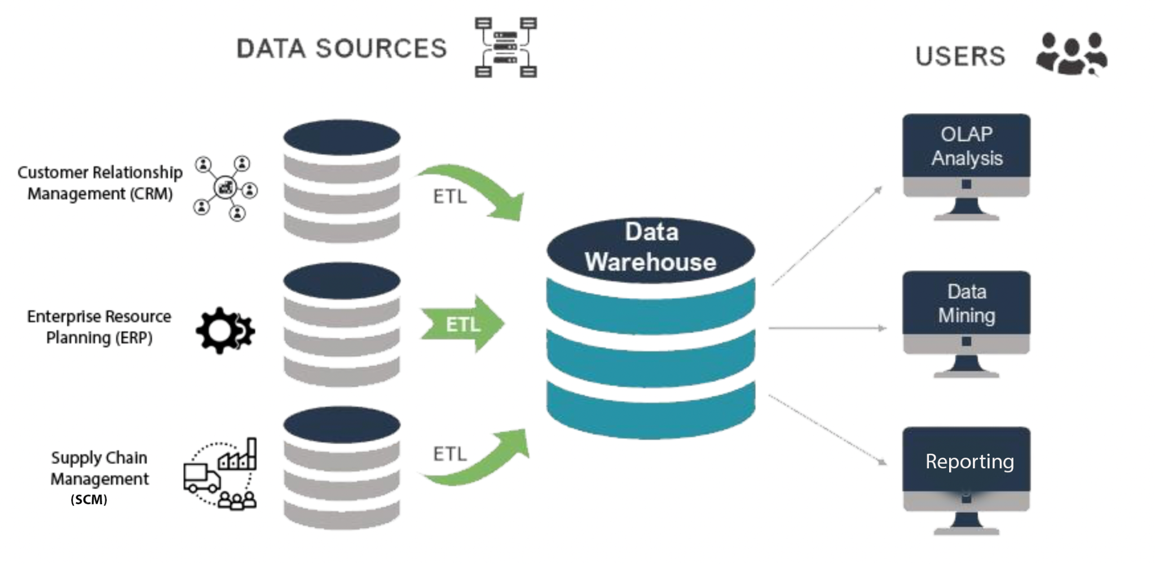
What is a Data Warehouse?
A Data Warehouse is a blend of technologies and components for the strategic use of data.
It collects and manages data from varied sources to provide meaningful business insights.
The primary use of the data stored is for query processing and analysis instead of transaction processing.
It employs a set of processes to transform data into actionable information.
26

Slide 27
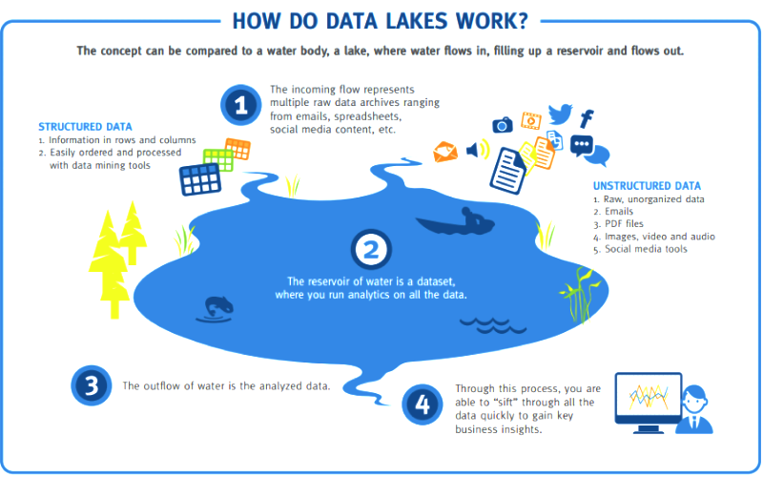
What is a Data Lake?
A Data Lake is a storage repository that can store a large amount of structured, semi-structured, and unstructured data.
It is a place to store every type of data in its native format with no fixed limits on account size or file.
It supports very large amounts of data for enhanced analytical performance and native integration.
27

Slide 28
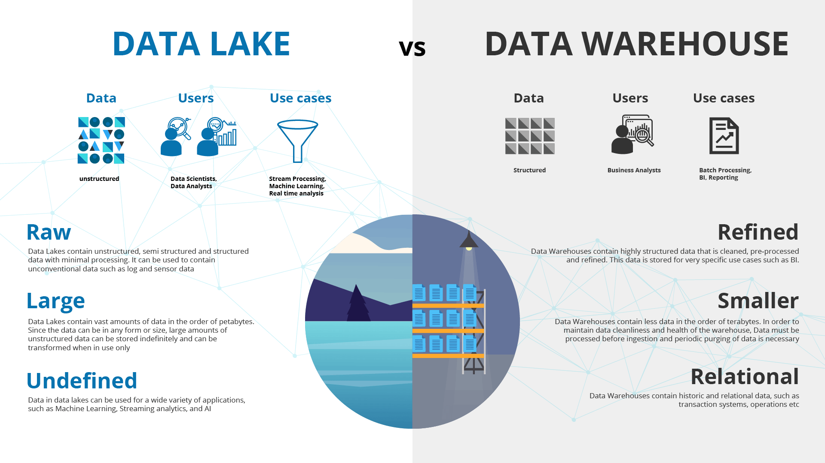
Data Warehouse vs. Data Lake
Source: @qubole
28

Slide 29
Data Warehouse vs. Data Lake
Parameters | Data Lake | Data Warehouse
Storage | All data is kept irrespective of the source Data stored in raw form Transformed when ready to use | Data from transactional systems consists of quantitative metrics with their attributes Data is cleansed and transformed before usage
History | Application of Big data in data lakes is relatively new | Data warehouse have been in use for decades
Data Capturing | Captures all kinds & types of data Structures, Semi-Structured and Unstructured | Structured information Organizes them in schemas
Data Timeline | Retain all data Includes data that it might use in the future Data is kept at all times for analysis | Significant time is spent on analyzing various data sources
Users | Ideal for the users (deep analyst) Include data scientists for advanced analytical processing | Ideal for operational users (structured, easy to use and understand)
Storage Costs | Big Data technologies are relatively inexpensive | Costlier and time-consuming
29

Slide 30
Data Warehouse vs. Data Lake
Parameters | Data Lake | Data Warehouse
Task | Empowers users to access data prior the process of transformation, cleansing, and giving it a structure | Provides insights into predefined questions for predefined data types
Processing Time | Allows users to get to their result more quickly | Any changes to the data warehouse require more time to take effect
Position of Schema | Schema is defined after the data are stored Requires work at the end of the process Offers high agility and ease of data capture | Schema is defined before data is stored Requires work at the start of the process Offers performance, security, and integration
Data Processing | Use of an advanced ELT (Extract, Load, Transform) process | Uses a traditional ETL process
Common Complaint | Data is transformed only when it is ready to be used | Any changes to the data warehouse need more time
30

Slide 31
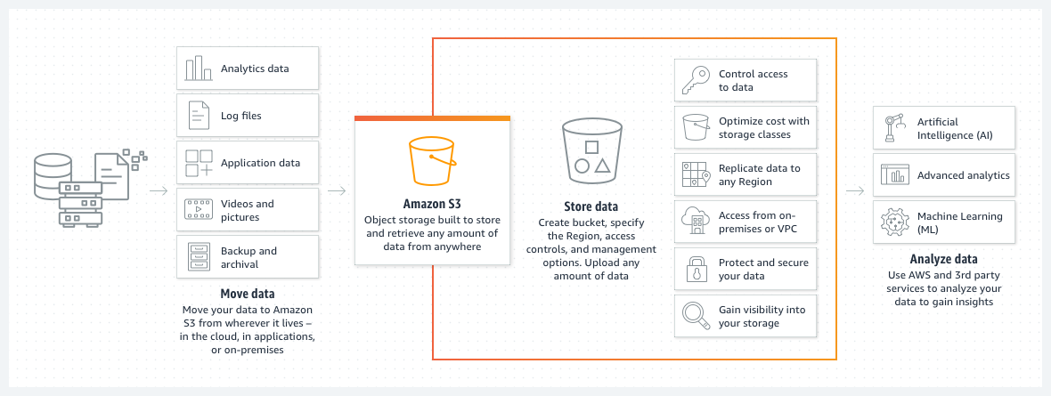
Amazon S3 - Cloud Object Storage
Secure, durable, highly-scalable object storage
Accessible via a simple web services interface
Store & retrieve any amount of data
Use individually or together with other AWS services
S3 or Simple Storage Service was one of the first services offered by AWS.
It is a serverless object storage that can be used by the tenants to store data.
It is well-suited for storing large amounts of unstructured data.
S3 also stores metadata to provide advanced search capabilities.
“Source: https://aws.amazon.com/s3/”
31

Slide 32
Know the terms
Buckets & Objects
Files in S3 are called objects. You can think of a bucket as a logical disk holding your objects.
Tenant
In cloud computing, users or clients are called Tenants.
Serverless
S3 is a fully managed service. No need to worry about backend management.
32

Slide 33
S3 Features
S3 Batch Operations
S3 Replication
Easily manage objects at scale with few clicks.
Replicate objects for reduced latency, disaster recovery, etc.
S3 Versioning
S3 Event Notification
Built to preserve, retrieve, or restore each version of a file.
Trigger workflows & alerts when a specific change is made.
S3 Select
Multi-Factor Authentication
Upto 4x increase in query performance & 80% reduction in query processing cost.
Enforce two forms of authentication to prevent accidental deletions.
S3 Transfer Acceleration
S3 Strong Consistency
Enjoy strong read-after-write consistency without additional cost.
Transfer files with increased speed over long distance.
33

Slide 34
Serverless vs. Managed Services

Slide 35
What is Serverless?
Serverless lets you run code without managing servers, with automatic scaling, built-in high availability, and a pay-for-use billing model.
Eliminates infrastructure management tasks such as server or cluster provisioning, patching, operating system maintenance, and capacity provisioning.
Loosely coupled event-driven applications powered using technology-agnostic APIs or messaging.
AWS Lambda is a serverless compute service that is well suited for event-driven architectures.
35
Notes:
Refresher from Cloud native discussion

Slide 36
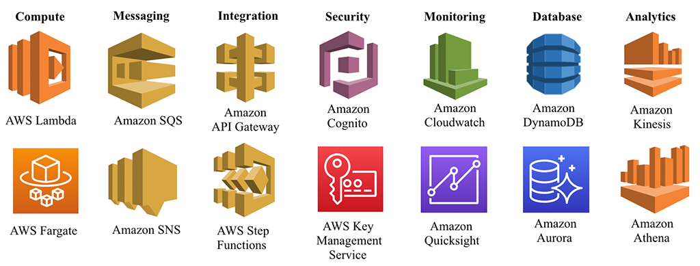
Serverless services on AWS
Compute provides the execution environment for your application code.
AWS messaging services enable different software systems and end-devices – often using different programming languages and on different platforms – to communicate and exchange information.
Application integration services enable communication between decoupled components within microservices, distributed systems, and serverless applications.
Security AWS provides data protection services through encryption, key management and threat detection. It continuously monitors and protects your accounts and workloads.
AWS monitoring allows you to verify the security and performance of your AWS resources and data.
AWS Cloud Databases let you modernize your data infrastructure with fully managed, purpose-built databases.
AWS analytics services help you to quickly extract data insights using the most appropriate tool for the job. They are optimized to give you the best performance, scale, and cost for your needs.
36

Slide 37
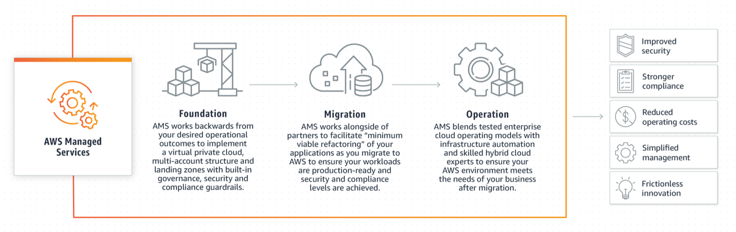
What are Managed Services?
AWS Managed Services is a set of services and tools that automate infrastructure management tasks for Amazon Web Services (AWS) deployments.
Aimed at large enterprises requiring a simplified way to migrate on-premises workloads to the public cloud and then manage them remotely.
Enables automated cloud management - including patch management, change management, provisioning, user access management, incident monitoring, and backup & restore operations.
Provide a dedicated Cloud Service Delivery Manager and Enterprise-level AWS Support coverage.
Source: https://aws.amazon.com/managed-services/
37

Slide 38
Serverless vs. Managed Services
Serverless | Fully Managed
Pay for what you use, e.g., paying only for the messages sent to a chatbot. | Paying for runtime for Machines
Machines are completely Opaque to Use | Number of Machines are visible and are replicated & highly available
No Server Management | No setup required Automatic Backups & Patching
38

Slide 39
Big Data Overview in AWS (Ingestion)

Slide 40
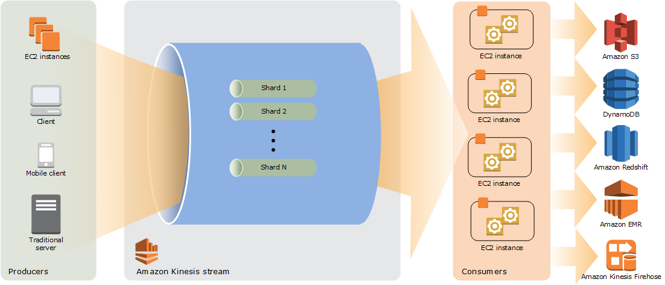
Amazon Kinesis
Makes it easy to collect, process, and analyze real-time, streaming data.
Get timely insights and react quickly to new information.
Enables you to ingest, buffer, and process streaming data in real-time.
Derive insights in seconds or minutes instead of hours or days.
Fully Managed and runs your streaming applications without requiring you to manage any infrastructure.
Source: https://docs.aws.amazon.com
Amazon Kinesis Architecture
40

Slide 41
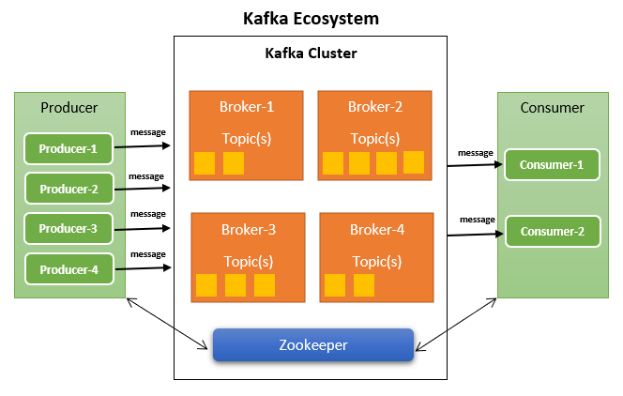
Kafka Overview
Distributed Event streaming platform.
Developed at LinkedIn in 2010, to simplify LinkedIn architecture.
Open sourced around year 2011.
Written in Java and Scala.
Publish-Subscribe based fault tolerant messaging system.
Can handle millions of messages per second.
Kafka stores messages in topics that are partitioned and replicated across multiple brokers in a cluster.
Producers publish messages to topics from which consumers read.
41

Slide 42
Amazon MSK
Amazon MSK is a fully managed service that removes the complexities of managing Kafka clusters so that you can focus on building real-time applications.
Fully compatible with Apache Kafka v1.1.1
AWS Management Console and AWS API for provisioning
Clusters are set up automatically
Provision for Apache Kafka brokers and storage
Create and tear down clusters on-demand
42

Slide 43
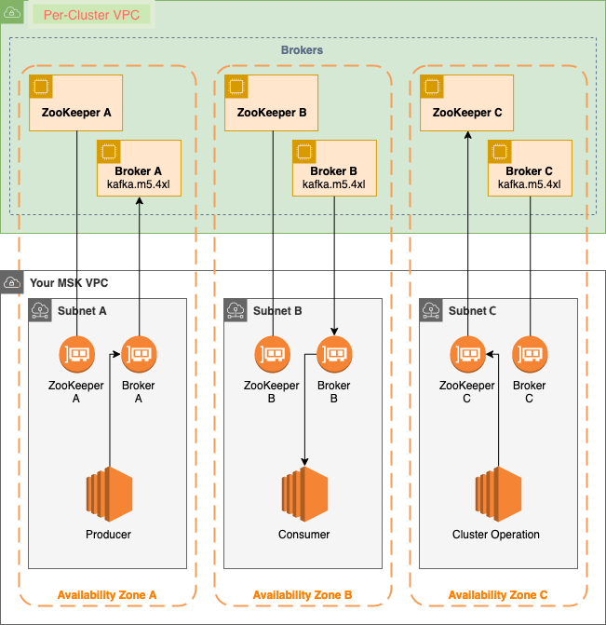
Amazon MSK works
Broker nodes — When creating an Amazon MSK cluster, you specify how many broker nodes you want Amazon MSK to create in each Availability Zone.
ZooKeeper nodes — Amazon MSK creates Apache ZooKeeper nodes for you.
Producers, consumers, and topic creators — Amazon MSK lets you use Apache Kafka data-plane operations to create topics and to produce and consume data.
Cluster Operations - Use the AWS Management Console, the AWS Command Line Interface (AWS CLI), or the APIs in the SDK to perform control-plane operations.
Source: https://docs.aws.amazon.com/mskl
43

Slide 44
Big Data Overview in AWS (Processing)
Notes:
The Scrubbing & Normalization step from before

Slide 45
Apache Spark
Apache Spark is an open-source, distributed processing system used for big data workloads.
Utilizes in-memory caching and optimized query execution for fast analytic queries against data of any size.
Provides development APIs in Java, Scala, Python and R.
Supports code reuse across multiple workloads — batch processing, interactive queries, real-time analytics, machine learning, and graph processing.
45

Slide 46
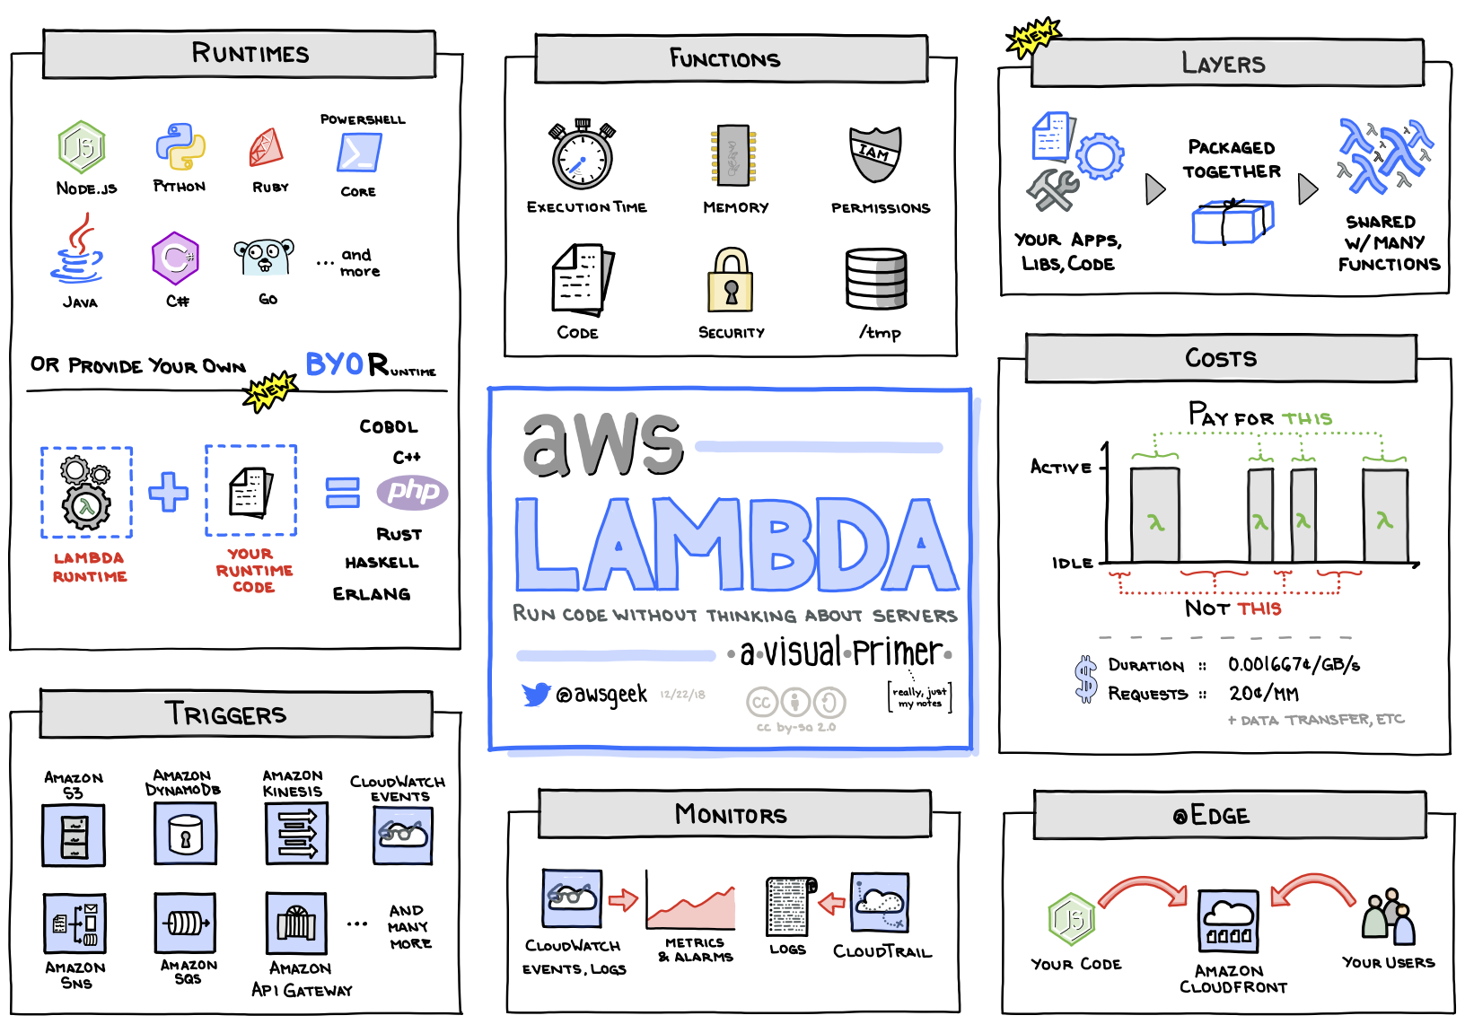
AWS Lambda
It is a compute service that runs your code in response to events and automatically manages the underlying compute resources for you.
You can use AWS Lambda to extend other AWS services with custom logic, or create your own back-end services that operate at AWS scale, performance, and security.
46

Slide 47
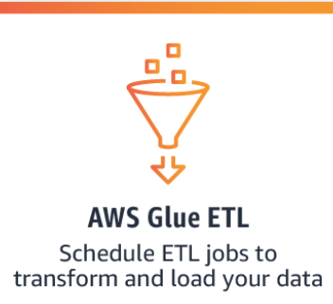
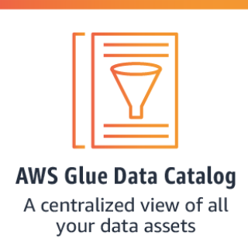
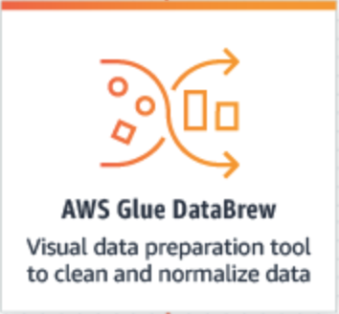
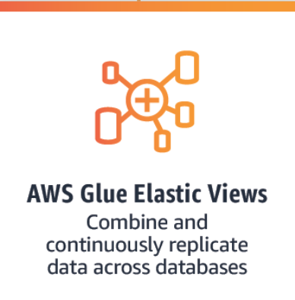
What is AWS Glue?
A fully managed extract, transform, and load (ETL) service that makes it easy for customers to prepare and load their data for analytics
Various Services of AWS Glue are:
47

Slide 48
Big Data Overview in AWS (Aggregation)

Slide 49
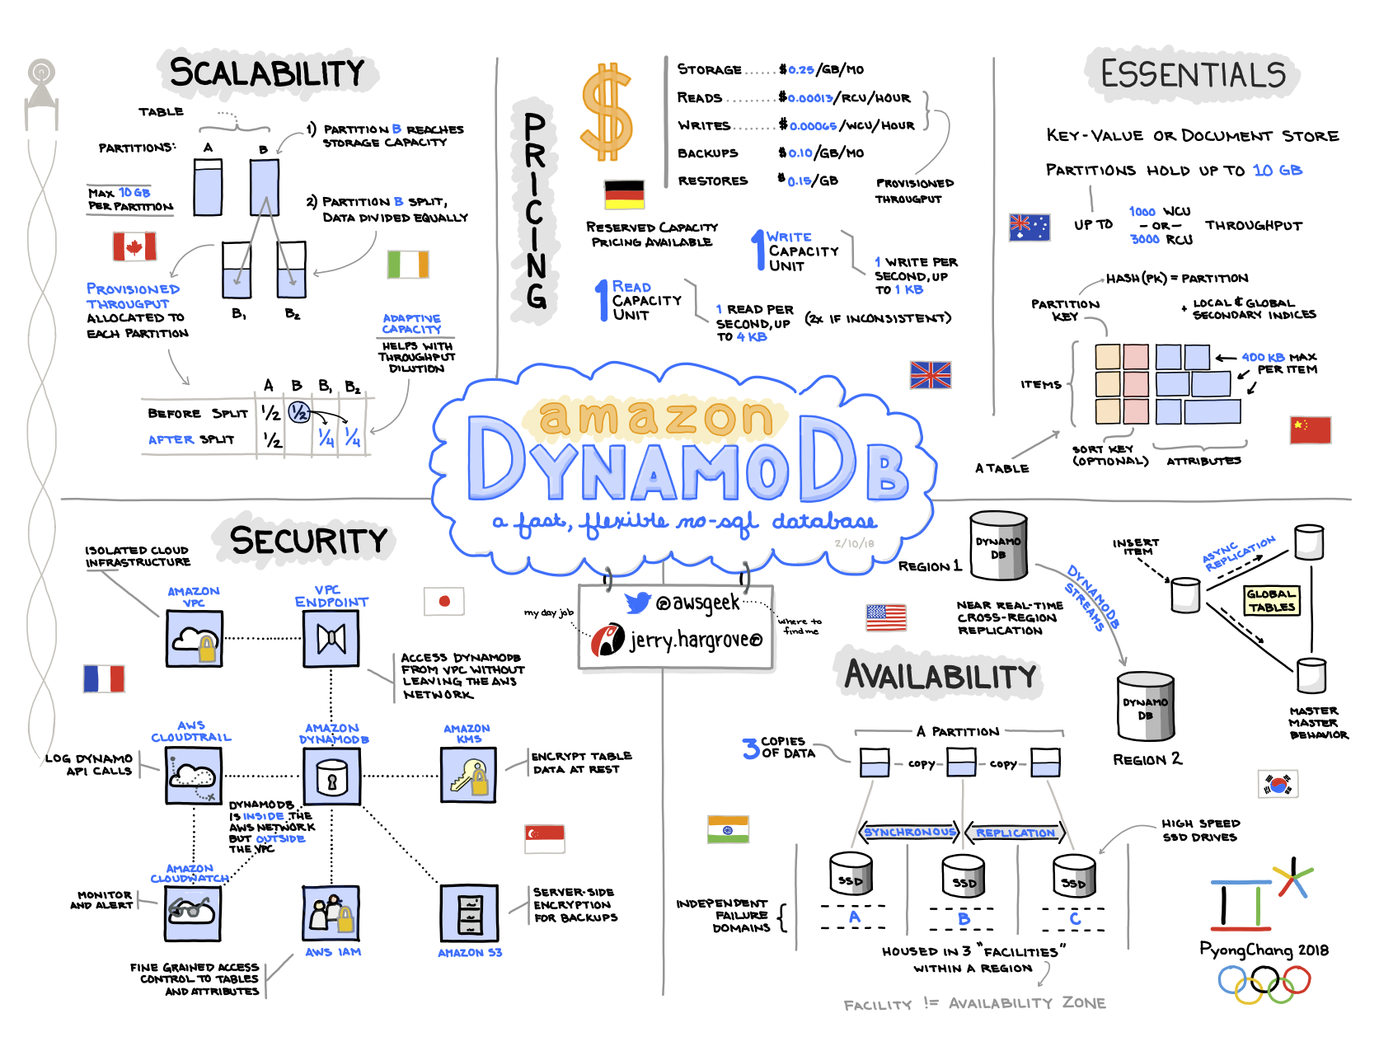
DynamoDB
Fully managed NoSQL database.
Store and retrieve any amount of data.
Autoscaling.
Highly available and durable (replicate across AZs).
On-demand backup and point-in-time recovery.
49

Slide 50
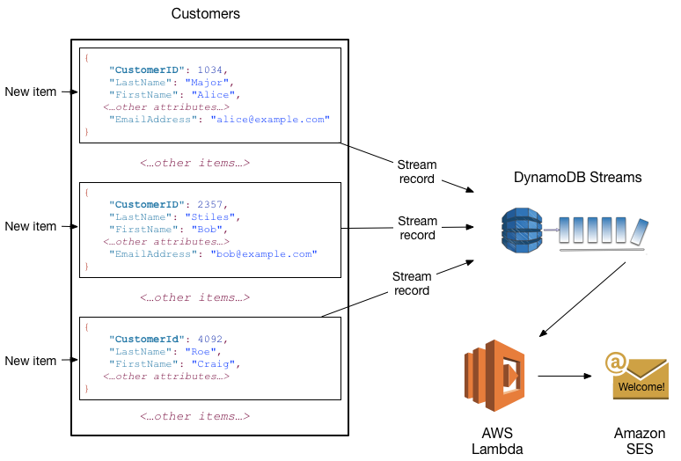
DynamoDB
50

Slide 51
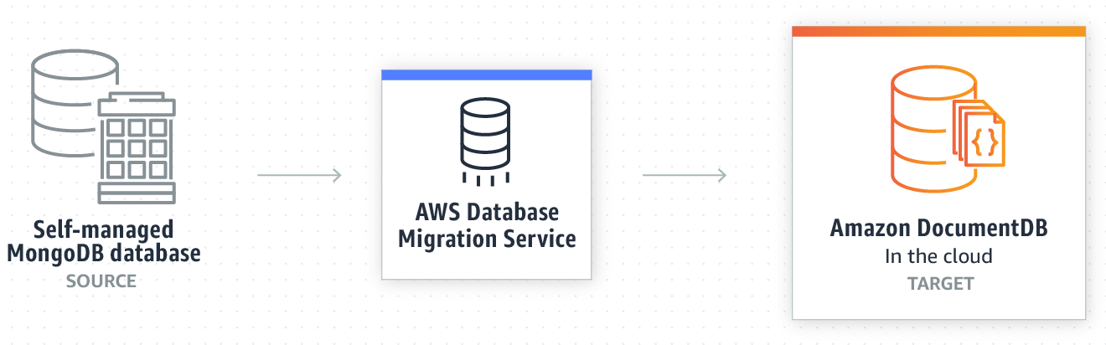
DocumentDB
It is a fully managed database service for operating mission-critical MongoDB workloads.
Highly Durable
Scalable
Set up, secure, and scale MongoDB-compatible databases without worrying about running cluster management software, configuring backups, or monitoring production workloads
51

Slide 52
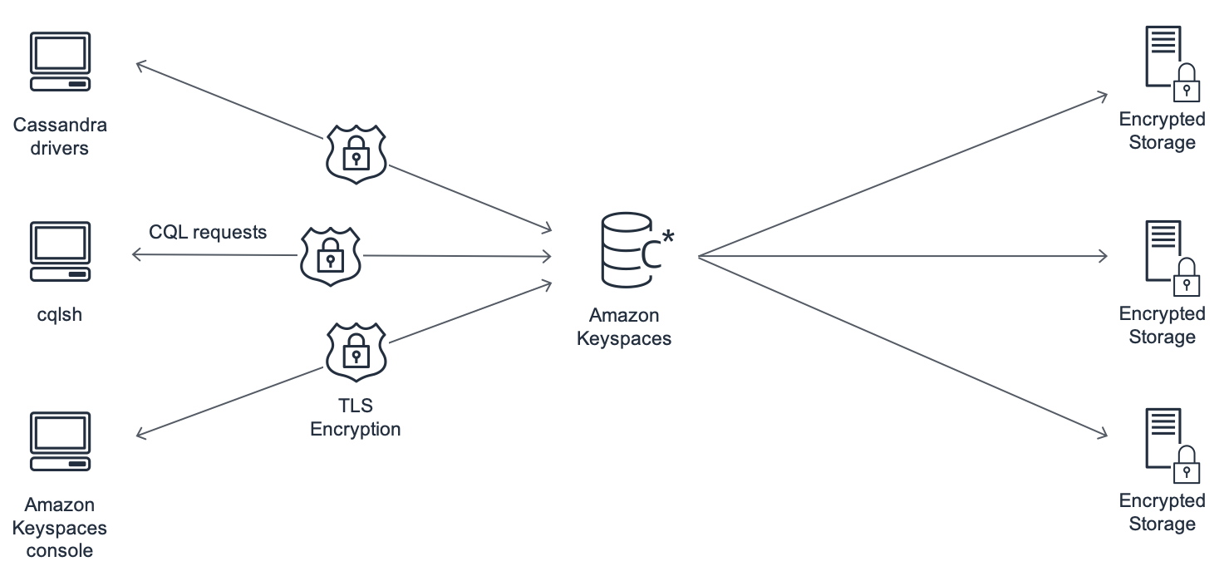
Amazon Keyspaces
Managed Apache Cassandra–compatible database service.
Scalable.
Highly Available.
No need to provision, patch, or manage servers.
No need to install, maintain, or operate software.
Build applications that serve thousands of requests per second with virtually unlimited throughput and storage.
52

Slide 53
Big Data Overview in AWS (Analytics)
Notes:
The Scrubbing & Normalization step from before

Slide 54
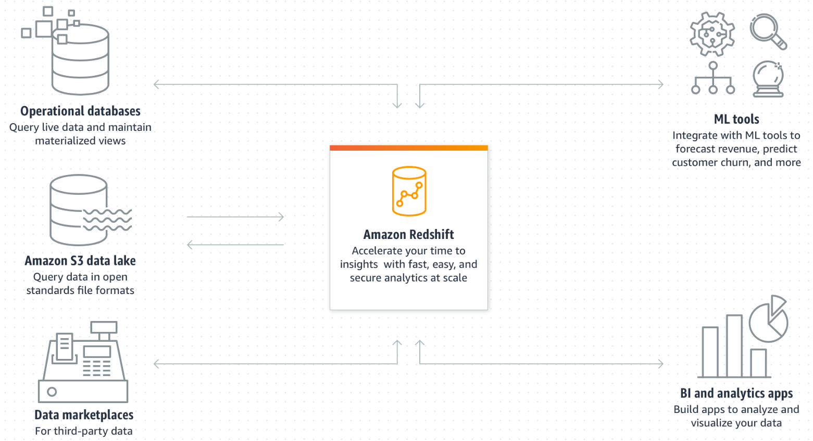
Redshift
Fully managed
AWS handles back ups, resizing, fault tolerance, etc.
Strong partner network.
Integrates well with other AWS services like S3, Kinesis.
Familiar interface
Acts like a Postgres-standard relational database.
Uses SQL for querying and management.
Optimized for performance
Column-store.
Massively Parallel Processing (MPP) architecture.
Can scale up to multiple petabytes.
Data compression.
Interleaved sorting.
Similar to Azure SQL Warehouse and Google BigQuery
Based on diagram by AWS
54

Slide 55
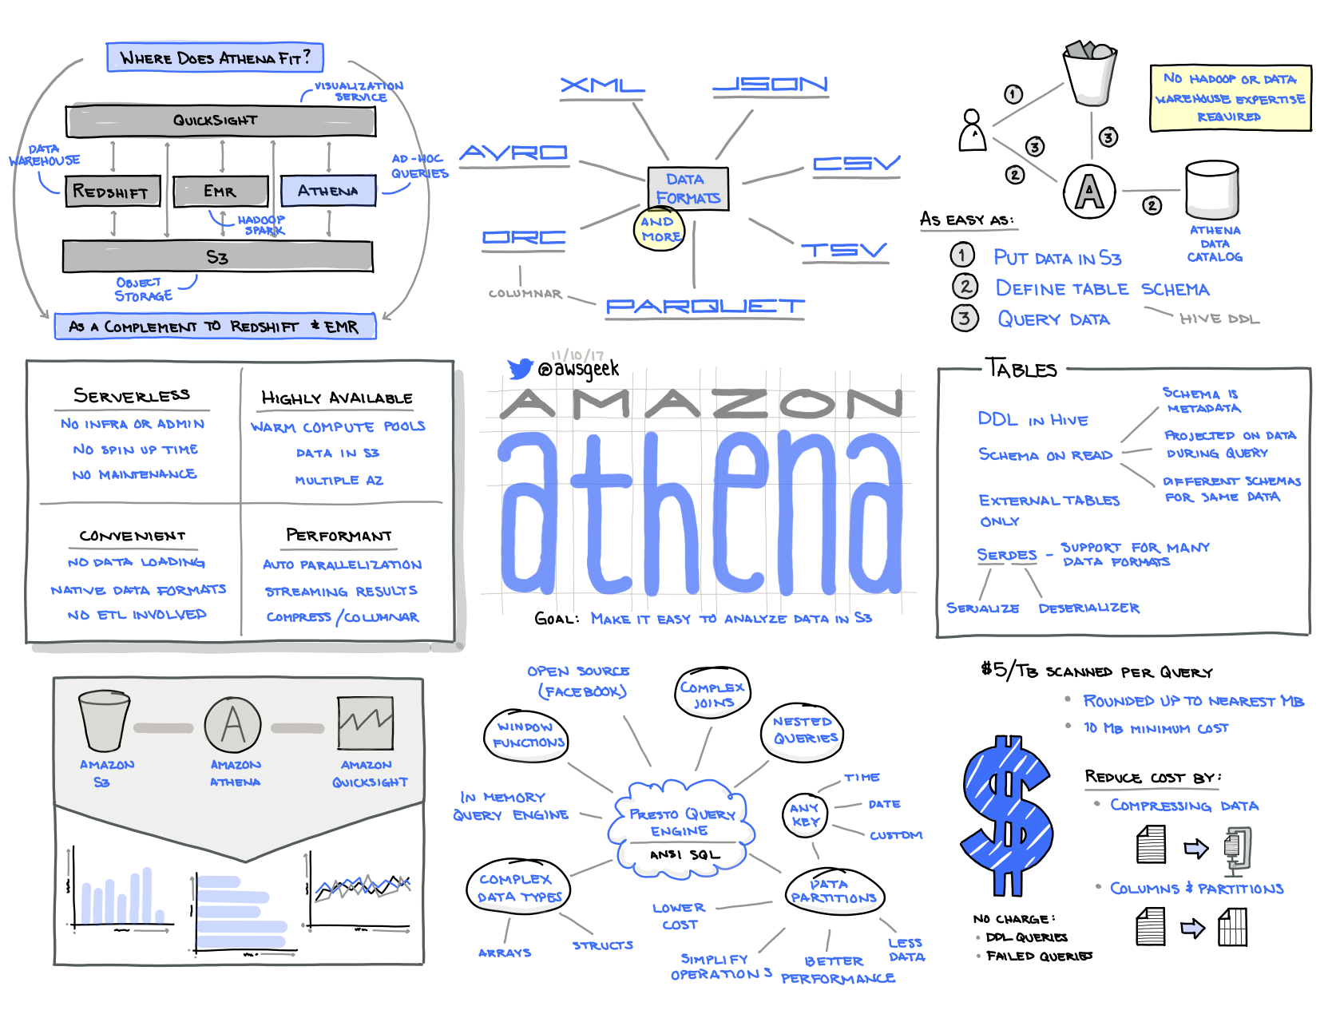
Athena
Interactive query service that makes it easy to analyze data in Amazon S3 using standard SQL.
Athena is serverless, so there is no infrastructure to manage, and you pay only for the queries that you run.
Easy to use.
55

Slide 56
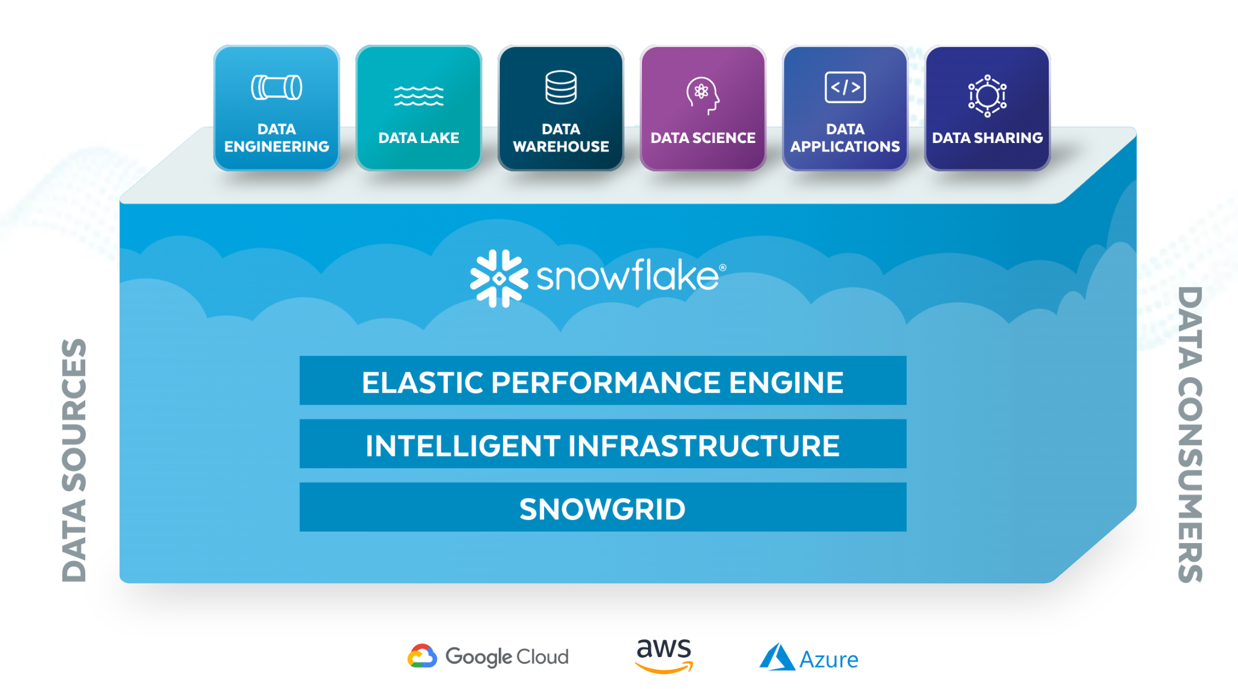
Snowflake
A single, global platform for your data and your essential workloads, with seamless data collaboration
Fully automated, so you can harness (without managing) the data.
Collaborate, globally and securely,
Optimal performance for any workload.
56

Slide 57

DEMO
Building a Simple Big Data Pipeline in AWS
Notes:
Walk students through sample flow → https://github.com/KernelGamut32/onboarding_data_engineering/blob/main/demos/data_engineering_demo.pdf

Slide 58




Thank you!
If you have additional questions, please reach out to me at:
erik-gross@pluralsight.com

